Slide 1
Attack Surface Analysis Model Creation
AVCDL-Design-3.1.1
Charles Wilson
Staff Product Cybersecurity Architect
version 2
2026-07-02
Notes:
Script:
I'm Charles Wilson, staff product cybersecurity architect at Tork Robotics.
This presentation will cover attack surface analysis model creation.

Slide 2
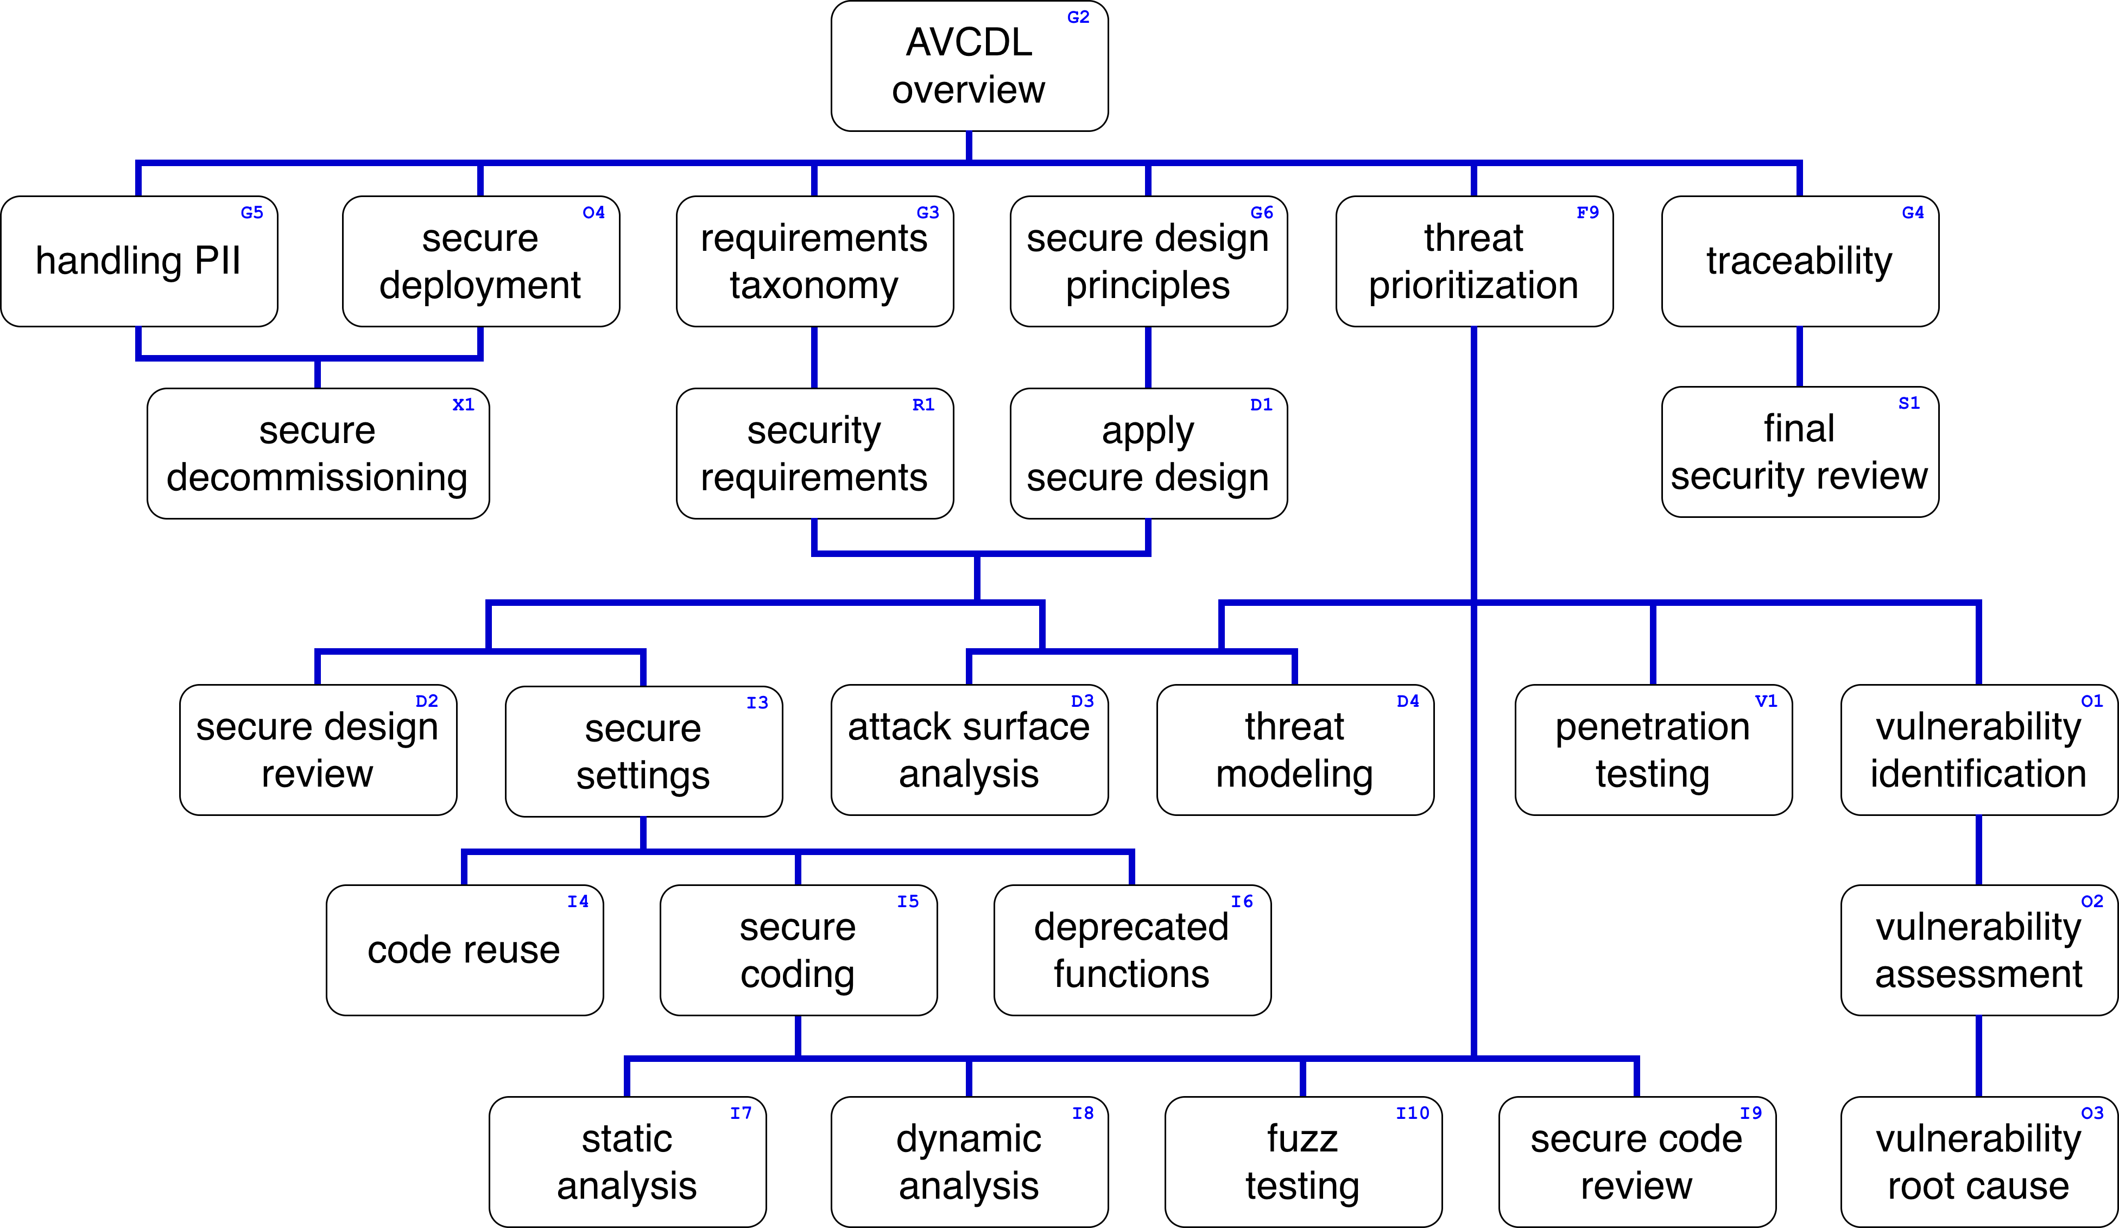
Training Path
Notes:
Script:
This diagram shows the overall AVCDL training path.
If you're taking this training, it's assumed that you've already completed the AVCDL overview training,
and additionally, that you've completed the
requirements taxonomy
security requirements
secure design principles
apply secure design
and
threat prioritization plan training
Additionally, you should have completed the attack surface analysis overview training.
This training will cover attack surface analysis model creation.

Slide 3
Introduction
Notes:
Script:
Before getting into attack surface analysis model creation, let's briefly review where it fits in the overall attack surface analysis process.

Slide 4
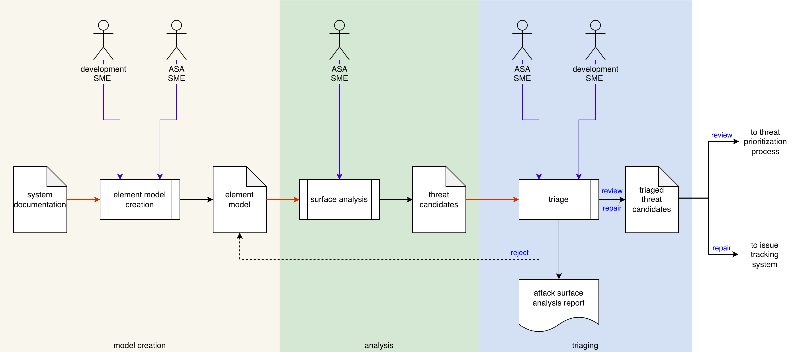
Attack Surface Analysis Process
Notes:
Script:
Here’s the overall attack surface analysis process workflow.
We have three individual activities,
<pause>
model creation,
<pause>
analysis,
<pause>
and threat candidate triaging.
Let’s consider the model creation activity.

Slide 5
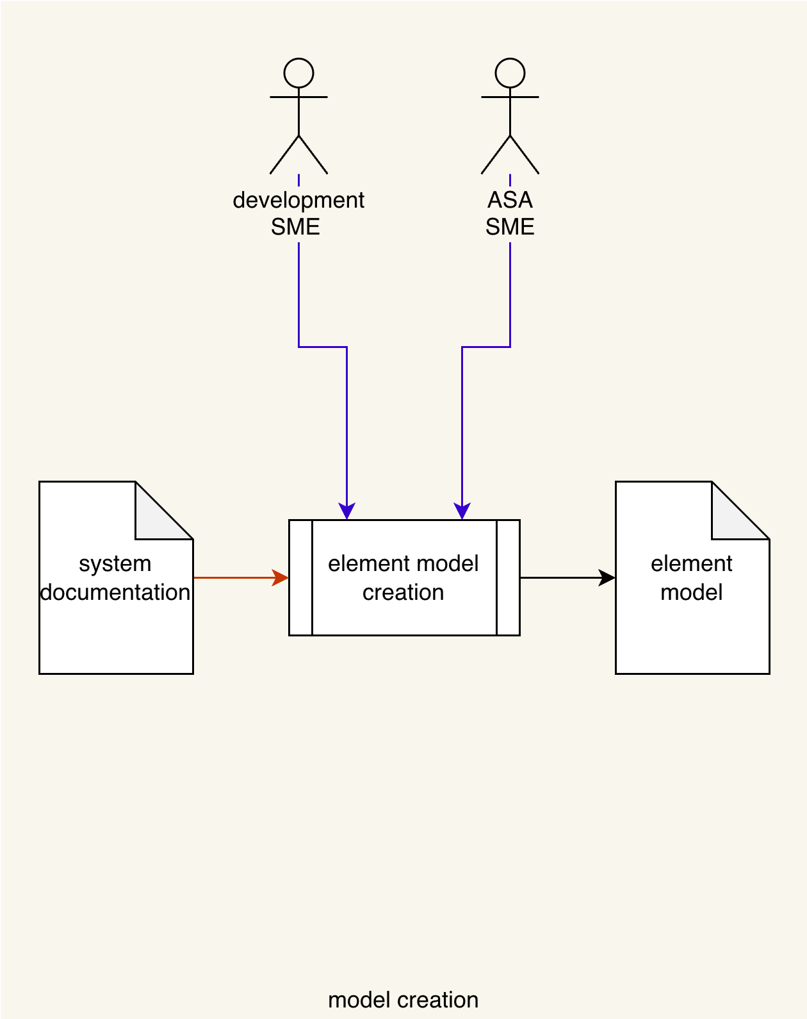
Model Creation Activity
Notes:
Script:
As the first activity in the attack surface analysis process, element model creation is arguably the most important.
The system documentation is considered by the development and attack surface analysis SMEs.
This results in the creation of an element model.
It's important to note here that the development SME or SMEs are not an optional participant in this activity.
This is because it is not the place of the ASA SME to guess as to the intentions and designs of the development team.
The ASA SME's purpose here is to facilitate the acquisition of information and to eventually create a representation of the element which is usable for the process of attack surface analysis.
[break]
If we consider the NIST threat modeling lifecycle, we see that we have
• diagramming
• identification
• investigation
• mitigation
and
• validation activities.
This lifecycle is equally applicable to how we handle attack surface analysis.
[pause]
The model creation activity is represented by the diagram portion of this.
That's all we're trying to accomplish here.
We're not looking into any deeper meaning behind what the various entities contained within the element model are.
We're merely attempting to identify what the potential attack surfaces of the element are.
This information will be used in the later analysis and triage activities.

Slide 6
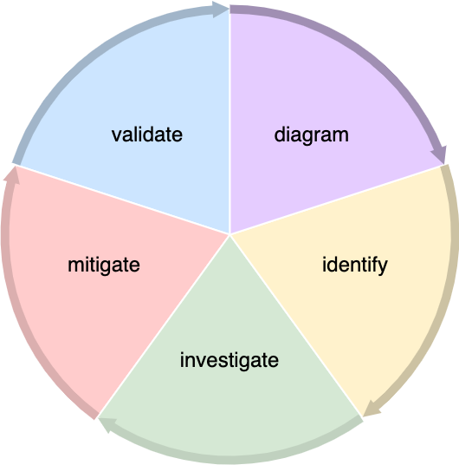
Model Creation Activity
Notes:
Script:
As the first activity in the attack surface analysis process, element model creation is arguably the most important.
The system documentation is considered by the development and attack surface analysis SMEs.
This results in the creation of an element model.
It's important to note here that the development SME or SMEs are not an optional participant in this activity.
This is because it is not the place of the ASA SME to guess as to the intentions and designs of the development team.
The ASA SME's purpose here is to facilitate the acquisition of information and to eventually create a representation of the element which is usable for the process of attack surface analysis.
[break]
If we consider the NIST threat modeling lifecycle, we see that we have
• diagramming
• identification
• investigation
• mitigation
and
• validation activities.
This lifecycle is equally applicable to how we handle attack surface analysis.
[pause]
The model creation activity is represented by the diagram portion of this.
That's all we're trying to accomplish here.
We're not looking into any deeper meaning behind what the various entities contained within the element model are.
We're merely attempting to identify what the potential attack surfaces of the element are.
This information will be used in the later analysis and triage activities.

Slide 7
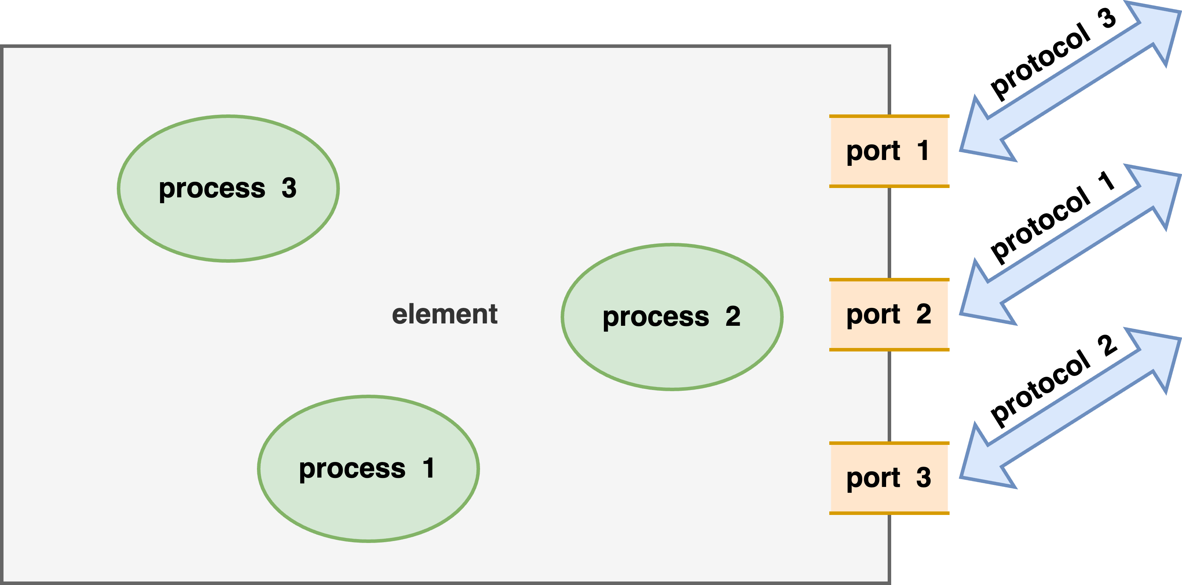
Areas of Interest
Ports
Protocols
Processes
Notes:
Script:
Models are by nature reductive, including only features necessary to the task, and even then, only at the fidelity that task requires.
There's no point in having a perfect digital twin if all you care about is a very small subset, because the effort required to create such a high-fidelity representation exceeds the amount of utility that you get out of the model itself in the context of the purpose that you've assigned it.
So, when we consider an attack surface analysis, we only have three areas of interest.
This diagram shows those, we have ports, protocols and processes.
We care about the physical holes in the element through which data can traverse.
We care about the protocols that are being used to convey that data.
And we care about the processes which are the end points for that data.
This is the totality of the needs that we have when we're doing an attack surface analysis.
It is the simplest ask that cybersecurity can make of development.
This is because it can be done on an as-is basis.
Additionally, these three features can be treated independently of each other and done at separate times, and there's still utility that can be gained from a partial analysis based on one of these three features.

Slide 8
Example
Notes:
Script:
With the conceptual aspects covered, let's work our way through an example that shows various aspects of how the element model creation activity is undertaken.

Slide 9
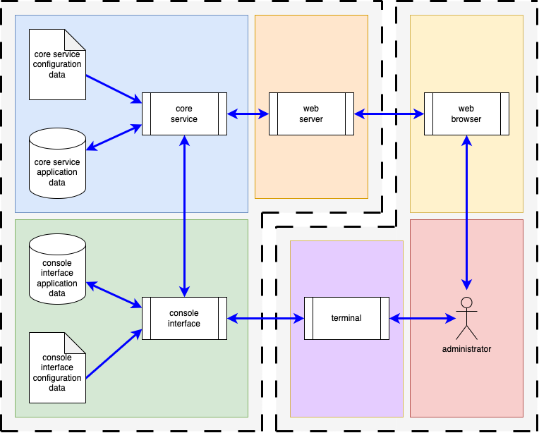
Block View
Notes:
Script:
Here's the example system that was shown in the attack surface analysis overview training.
Let's get into how we're going to translate this system into an element model suitable for attack surface analysis.

Slide 10
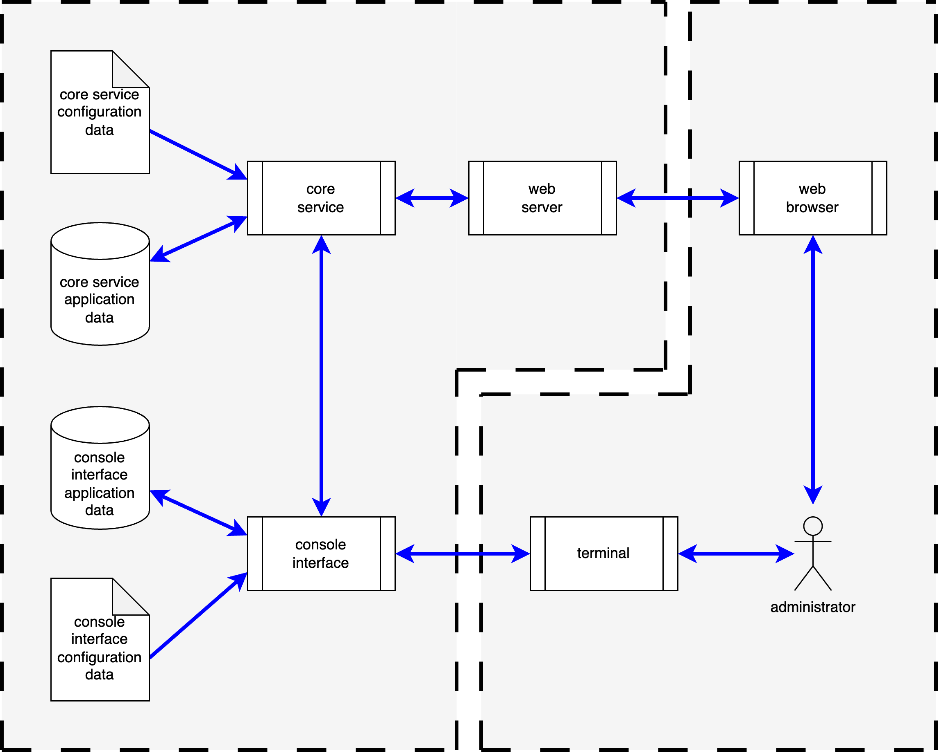
Entities
Notes:
Script:
First, we'll drop the functional boundaries and just leave ourselves with the entities that the system has.

Slide 11
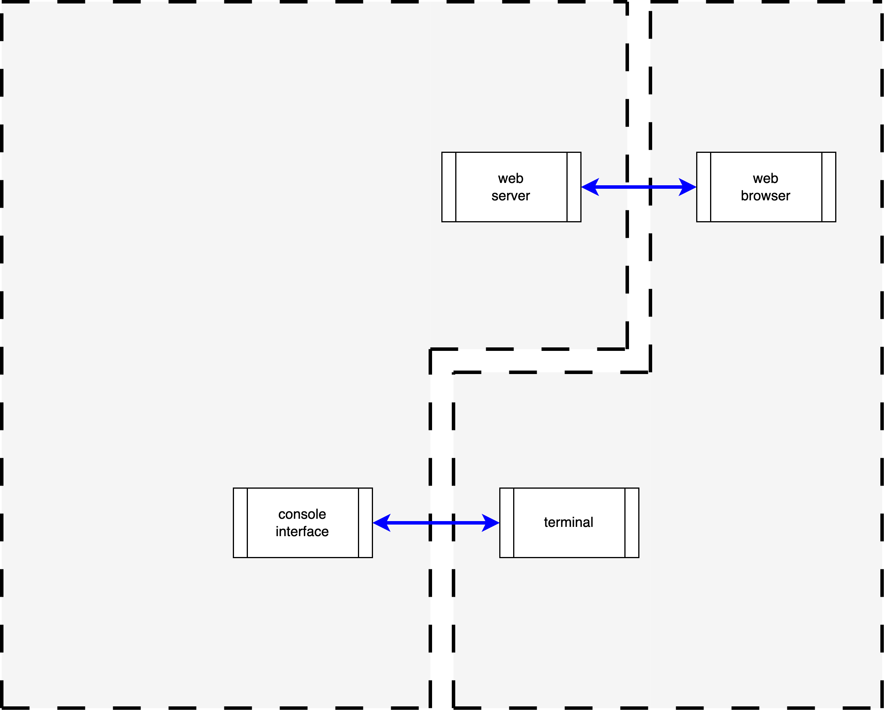
Interfaces
Notes:
Script:
Next, we'll eliminate everything that doesn't touch an interface.
This leaves us with the web server web browser entity pair, and the console interface terminal entity pair.
We can take this a bit farther because we aren't responsible for the right half of this diagram, because that's the interacting entity.
All we really care about is the web server, its connectivity, and the console interface and its connectivity.
All the other information that we were presented is unnecessary for us to undertake an attack surface analysis.

Slide 12
Documenting
Notes:
Script:
Now that we have our minimal diagram for the element model, the next step is to begin documenting the information that we talked about earlier, those three features, the ports, the protocols, and the processes.
So, let's get into that.

Slide 13
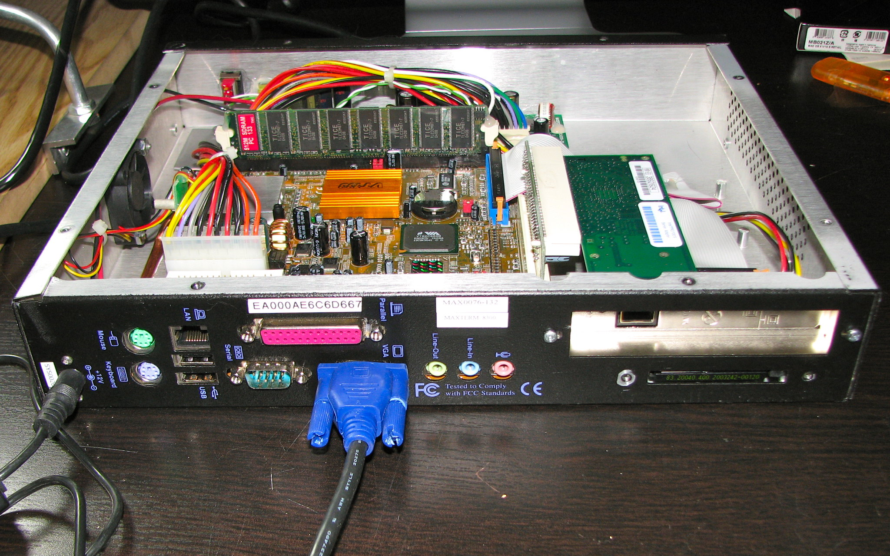
Physical Ports *
* System Back (links in references)
Notes:
Script:
Development has provided an image of the system that they're going to be using.
This differs quite a bit from the minimal nature of the diagram that we just created.
What we have is a standard PC.
It has the capability of doing all the operational things the system is supposed to do, but there are extra ports.
[break]
If we fade the system out and go to a simplified view of the physical ports, which is something that should be created, we can see that we have not only the network interface, necessary for the web server to web browser, and the serial port necessary for the console interface to terminal, but we have an extra network port, audio ports, keyboard and mouse ports, a video port, a parallel port, and a PCMCIA interface.
To simplify the way we will address these, we put each physical port into one of four categories.
The first are the ports that are required for production use, and we've talked about those already.
These are the serial port and an Ethernet port.
The next set are the ports used for diagnostic purposes.
This might be a JTAG port, or an additional network port that is sending information somewhere else separate from the purposes of the system itself.
The next set are ports that are required for pre-production use.
In this case, the mouse, keyboard, and video ports, are used to monitor the system during development.
Finally, there might be ports that are unused.
In this example, audio ports might not be used at all.
Each of these categories will have a different treatment when analysis is performed.
The specifics of how these categories are treated will be addressed in the attack surface analysis model analysis training.

Slide 14
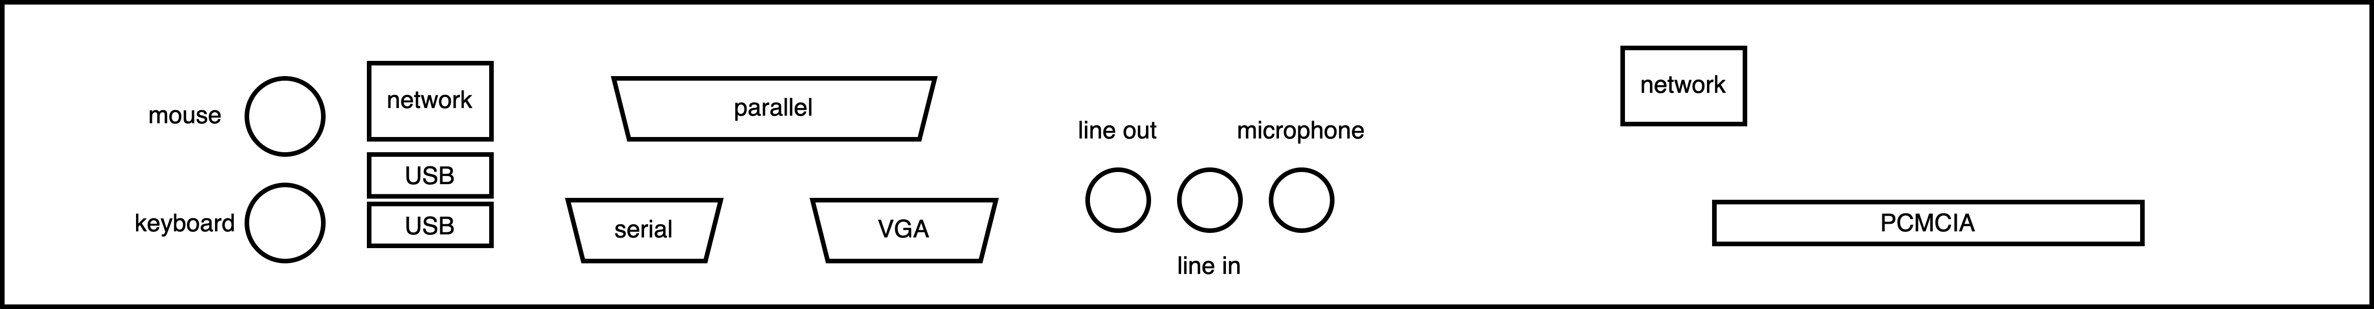
Physical Ports
Notes:
Script:
Development has provided an image of the system that they're going to be using.
This differs quite a bit from the minimal nature of the diagram that we just created.
What we have is a standard PC.
It has the capability of doing all the operational things the system is supposed to do, but there are extra ports.
[break]
If we fade the system out and go to a simplified view of the physical ports, which is something that should be created, we can see that we have not only the network interface, necessary for the web server to web browser, and the serial port necessary for the console interface to terminal, but we have an extra network port, audio ports, keyboard and mouse ports, a video port, a parallel port, and a PCMCIA interface.
To simplify the way we will address these, we put each physical port into one of four categories.
The first are the ports that are required for production use, and we've talked about those already.
These are the serial port and an Ethernet port.
The next set are the ports used for diagnostic purposes.
This might be a JTAG port, or an additional network port that is sending information somewhere else separate from the purposes of the system itself.
The next set are ports that are required for pre-production use.
In this case, the mouse, keyboard, and video ports, are used to monitor the system during development.
Finally, there might be ports that are unused.
In this example, audio ports might not be used at all.
Each of these categories will have a different treatment when analysis is performed.
The specifics of how these categories are treated will be addressed in the attack surface analysis model analysis training.

Slide 15
Required for production use
Diagnostic use
Required for pre-production use
Unused
Notes:
Script:
[NOTE: this is just an overlay]

Slide 16
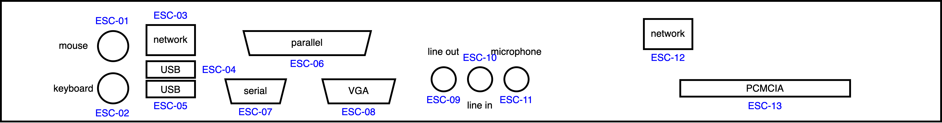
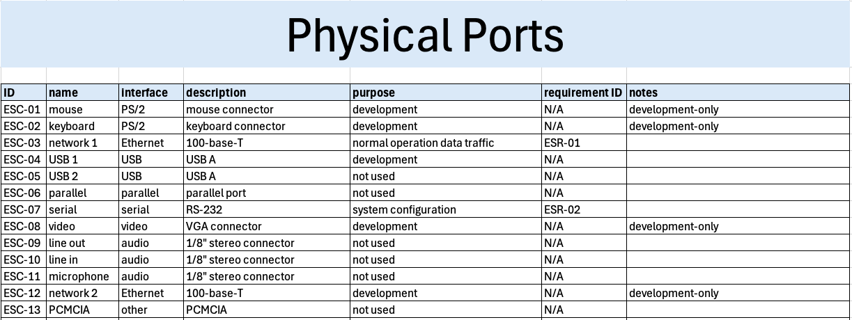
Physical Ports
Notes:
Script:
And here we show the physical ports sheet of the attack surface analysis model creation workbook filled out and showing the diagram of the physical ports.
You'll notice that every physical port has been given a unique identifier, so that when we talk about it, we're not hand waving.
For instance, we have two USB ports, we want to be able to know which is which.
Similarly, we've got two network ports.
We need to be able to disambiguate which one we're talking about.
So, everything gets a unique ID.
[pause]
They all have common names.
[pause]
We indicate the interface that is being used.
[pause]
And a description of it.
[pause]
As well as its purpose.
For ports that are operationally required, this is the specific purpose. Otherwise, just list one of the other three port types just mentioned.
[pause]
If the port is operationally required, the functional requirement ID supporting it needs to be indicated.
The need for a functional requirement will also be true for protocols and processes.
[pause]
And finally, some notes there.
Noting that ports are development-only will be helpful later when doing analysis and triage.
[pause]
Taken together we can, for example, say that we have port ESC-03 which is a 100-base-T Ethernet port used for normal operation of data traffic, supported by requirement ESR-01 for communication between the web server and web browser.

Slide 17
Logical Ports / Protocols
Notes:
Script:
Next, we're going to look at protocols.
This is grouped together with logical ports because the primary focus of this feature is to address things which are connected using the traditional networking systems which allow for multiple protocols on a shared medium.
Ethernet would be one example of this. CAN being another.
Logical ports are simply IDs within a data packet which allow you to differentiate data streams.
Going back to our diagram that shows our interfaces, we can see that we have a web server, web browser pair, and a console interface and terminal pair.
The console interface and terminal are communicating over an RS-232 style serial interface, so there's no protocol here.
It's strictly a single end-to-end connection, and not what we're focusing on.

Slide 18
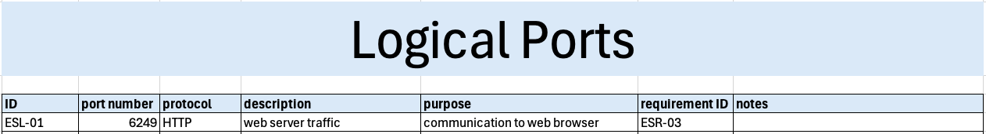
Logical Ports / Protocols
Notes:
Script:
In our case, we know that we have a network connection, and we've enumerated it here as ESL-01 (Example Logical Port 1).
It has a port number, and protocol associated with it.
It's this port-protocol combination that we tend to look at later.
[pause]
We show its description,
[pause]
its purpose,
[pause]
and its requirement ID.
[pause]
One could hypothetically say that this connects to a particular physical port, but for the purposes of our analysis, that's not necessary.
It is an interesting association to make, however.

Slide 19
Processes
Notes:
Script:
Finally, we have the processes feature.
Jumping back to our entities diagram, we can see that we have three processes here in the context of the element.
They are the web server, the core service, and the console interface.
We're going to enumerate all of them.
This is not strictly necessary, but it is helpful to have this list as we look at particular issues later.

Slide 20
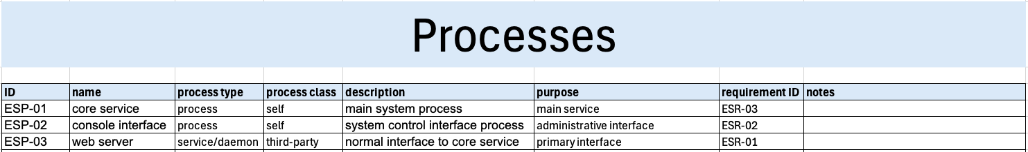
Processes
Notes:
Script:
Here we show our three processes, all having been given an ID.
In this case, they are prefixed by ESP (Example System Process).
We've got a name for each,
[pause]
a process type,
[pause]
and process class.
[pause]
Two are processes
[pause]
and one is a service or daemon.
[pause]
Two of these processes are owned by us.
[pause]
One is supplied by a third-party.
This ownership is not significant to attack surface analysis, but in threat modeling analysis, it is.
[pause]
We have descriptions,
[pause]
purpose,
[pause]
and the requirement each ties back to.

Slide 21
Recap
Notes:
Script:
And that's it.
It really is that simple.
There are three features we care about (ports, protocols, and processes).
They need to be identified.
They need to have diagrammatic representations so we can communicate about them.
They need to have unique entity identifiers and attributes identified as necessary.
Collectively, this material can be considered as the attack surface model for the element.
We can take it to the next step, which is to do analysis.

Slide 22
Example Materials
<AVCDL>/source/reference_documents/working_material/example system/
Notes:
Script:
The materials that were used to cover this example are in this location shown here.

Slide 23
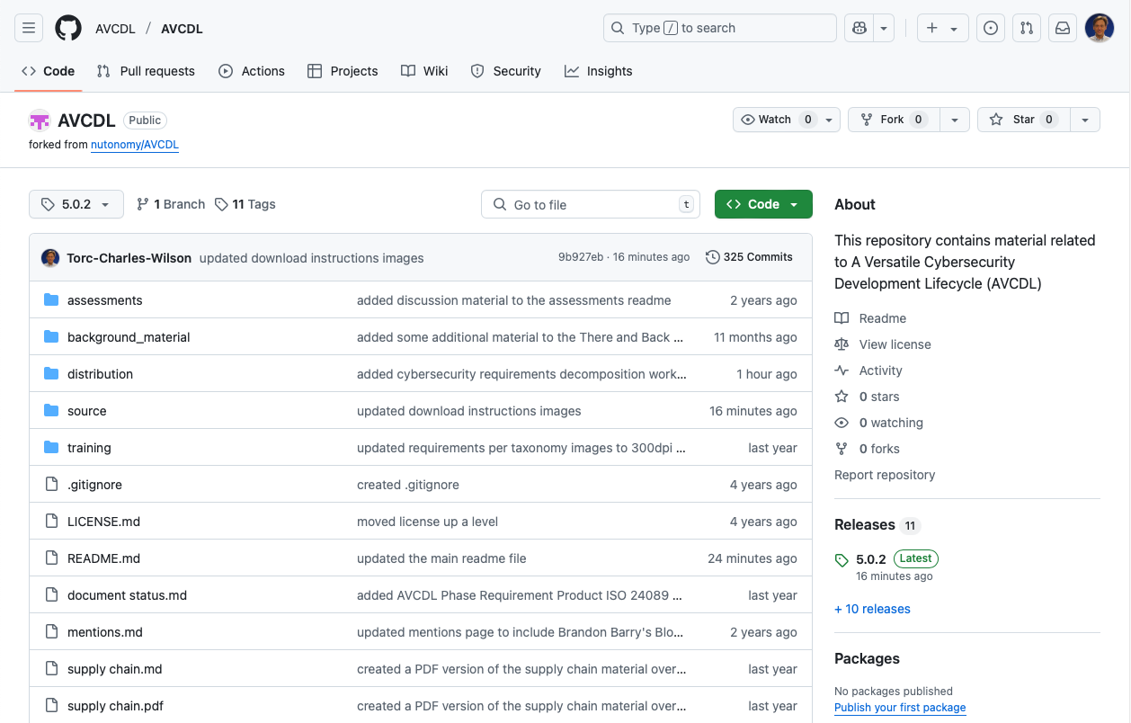
AVCDL on GitHub
https://github.com/AVCDL/AVCDL
Notes:
Script:
All AVCDL materials, both in source and distribution forms, are available on our GitHub site, as shown here.
Because of the size of the repository, it's recommended that you either clone the repository or download a ZIP archive of it, if you're not familiar with using git.
Instructions for downloading a ZIP archive are linked to on the repository’s front page.

Slide 24
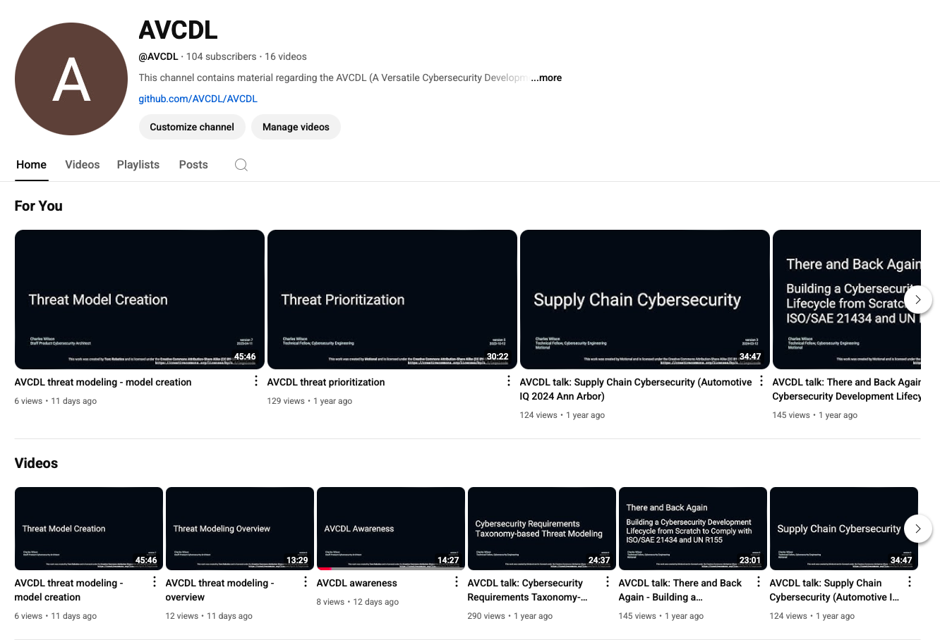
AVCDL on YouTube
https://youtube.com/@AVCDL
Notes:
Script:
A set of training videos have been created to cover various aspects of the AVCDL that follow the training path found in the AVCDL primary document.
It's important to note that all AVCDL materials except for the introductory blog posts are intended for product cybersecurity engineering practitioners.

Slide 25
Next Steps
Notes:
Script:
The next trainings in the attack surface analysis sequence are model analysis and threat candidate triage.
Once you've completed all trainings related to attack surface analysis, you can proceed to one of the other trainings at this level.
These include:
• threat modeling
• penetration testing
and
• vulnerability identification
Additionally, if you've completed secure coding and its prerequisites, you can also proceed to:
• static analysis
• dynamic analysis
• fuzz testing
and
• secure code review

Slide 26
References
AVCDL primary document
Attack Surface Analysis Model Creation Procedure (AVCDL tertiary document)
AVCDL attack surface analysis model template (AVCDL template)
Guide to Data-Centric System Threat Modeling
https://csrc.nist.gov/publications/detail/sp/800-154/draft
System Back (Bill Bradford, CC BY 2.0)
https://www.flickr.com/photos/41894183508@N01/3759951495
https://creativecommons.org/licenses/by/2.0/
Notes:
Script:
Here are references to the source material used in the creation of this presentation.
They'll also be included in the video description.
Additionally, this presentation’s source material will be provided on the AVCDL GitHub repository.

